Slide 1
SML GROUP PROJECT MALWARE PREDICTION
Group 5
Roxane Smadja
Paul Cazilhac
Alessandro Varnelli

Slide 2


Business Problem
Malware industry: well-organized market that evade the traditional security measures.
Harm the computer, destroy it, collect and affect confidential information
Microsoft with more than one billion enterprise and customers has a goal: Anticipate the malware infection to secure users and companies.

Slide 3
Data Description
Unique identifier: MachineIdentifier
Target: HasDetections
82 predictors
Test Set : 7 853 253 rows
Train Set: 8 921 483 rows
Work on 10% of data

Slide 4
Hardware specific
System specific
EDA: feature nature
AVProductsInstalled
AVProductsEnabled
Platform
Firewall
SkuEdition - Important
OsVer
OsBuild
OsSuite
OsPlatformSubRelease
OsBuildLab
IsProtected
PuaMode
SMode
IeVerIdentifier
SmartScreen
Census_OSVersion
Census_OSInstallTypeName
Census_IsPortableOperatingSystem
Census_IsFlightsDisabled
Census_FlightRing
Census_IsFlightingInternal
Census_GenuineStateName
Processor
Census_IsVirtualDevice
Census_IsPenCapable
Census_IsTouchEnabled
Census_MDC2FormFactor
Census_IsAlwaysOnAlwaysConnectedCapable
Census_ProcessorCoreCount
Census_OEMModelIdentifier
Census_OEMNameIdentifier
Census_ProcessorClass
Census_PrimaryDiskTotalCapacity
Census_PrimaryDiskTypeName
Census_SystemVolumeTotalCapacity
Census_HasOpticalDiskDrive
Census_TotalPhysicalRAM
Census_InternalPrimaryDiagonalDisplaySizeInInches
Census_ChassisTypeName
Census_InternalPrimaryDisplayResolutionHorizontal
Census_InternalPrimaryDisplayResolutionVertical
HasTpm
Software specific
User specific
CountryIdentifier ​
CityIdentifier ​
OrganizationIdentifier ​
GeoNameIdentifier ​
LocaleEnglishNameIdentifier​
Census_OSInstallLanguageIdentifier ​
Census_OSUILocaleIdentifier​
Census_OSWUAutoUpdateOptionsName​
Wdft_IsGamer ​
Wdft_RegionIdentifier ​
ProductName
EngineVersion
AppVersion
AvSigVersion
IsBeta
IsSxsPassiveMode
DefaultBrowsersIdentifier
Census_ActivationChannel
Notes:
(did different installation method imply more risks?)

Slide 5
Data Preparation
Delete variables with no variance
Delete variables with more than 90% missing values
Create flag for missing values for all columns
Missing values in Categorical variables :
Less than 30% missing values: replace by the mode
More than 30% missing values: replace per "missing"
Missing values in Numerical variables :
Less than 300 unique values: replace by 0
Many unique values (some more than 7000) replaced by mean or mode depending on the case
Dummy encoding for the binary variables, dropping first column
Replace categorical variable per % of incidence

Slide 6
Feature engineering
We realize that very few variable were numerically significant.
We decided to create 3 new Variables from them:
Memory: mean of all variables relative to the memory
Computer Performance: Mean of all variables relative to technical performance
Material Features: mean of all numerical variable regarding computer features
All the original variable have been standardized from 0 to 1 before calculations

Slide 7



Feature selection
Pearson R test
Variables with P-Value > 0.05 were removed
Feature reduction from 83 available to just 61 selected

Slide 8


Modeling
Test Set
30%
70%
Train Set
Number of Features: 61
Number of observation in Training Set : 535755
Number of observation in Test Set : 229610

Slide 9

Instantiating the Models
Implementing the following models on train set:
Logistic Regression
K Nearest Neighbours
Random Forest
Neural Network
Gradient Boosting

Slide 10
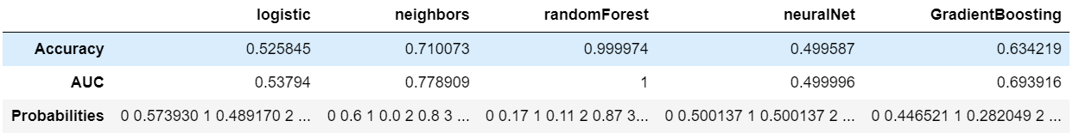
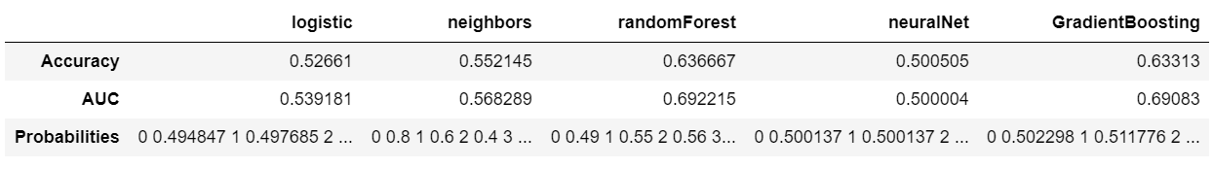
First results on Training Set
First results on Test Set

Slide 11
Grid Search
Logistic Regression: Testing 15 different combinations including 3 Solvers
K Nearest Neighbours : Testing 320 different combinations
Random Forest: Testing 15 combinations
Neural Network: Testing 21 combinations
Gradient Boosting: Testing 512 combinations

Slide 12
Hyper Parameters
Logistic Regression: C= 10, penalty= l2, solver= newton-cg
K Nearest Neighbours : algorithm= ball_tree, leaf_size= 10, metric= Manhattan, n_neighbors= 15, weights= distance
Random Forest: max_features= auto, n_estimators=600
Neural Network: alpha= 0.1, hidden_layer_sizes= 9, max_iter= 500, random_state= 6, solver= lbfgs'
Gradient Boosting: criterion=friedman_mse, learning_rate= 0.1, loss= deviance, max_depth= 3, max_features= sqrt, min_samples_leaf=2, min_samples_split=0.2, n_estimators= 150, subsample= 0.85)

Slide 13
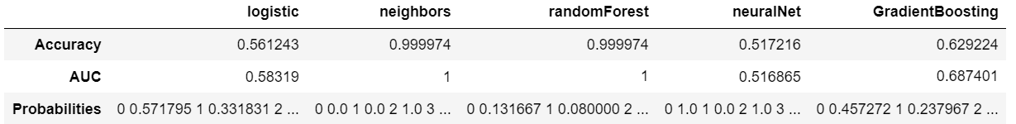
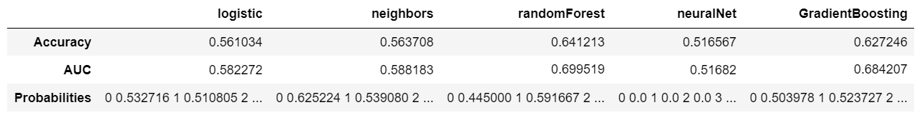
Results on Training Set after Tuning Hyper Parameters
Results on Test Set after Tuning Hyper Parameters

Slide 14


Evaluation
Implementing the models on the whole test set is not feasible because of its size, so the results refer only to the subset analyzed
By comparing all the models, the best performing one on the test set is the Boosted Tree with 0.69 AUC on test set
Notes:
(randomForest was overfitting on train)

Slide 15
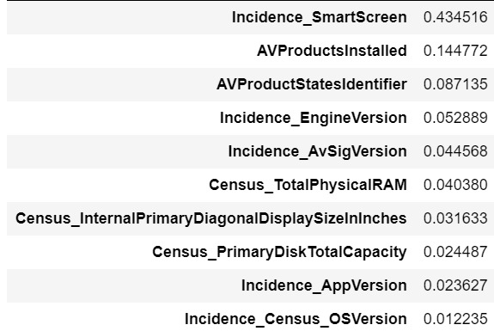
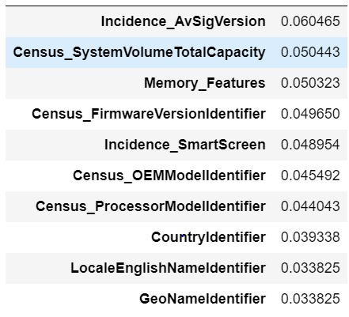
Conclusion
Most significant factors for:
Gradient Boosting Tree
Random Forest

Slide 16
Thank you!
Q&A

